Slide 1
UC Berkeley Summer Sessions
2024
Information Session
Notes:
Play virtual campus tour: https://www.youtube.com/watch?v=XzU_erbKBFc
Hello and welcome to our UC Berkeley Summer Sessions 2024 Information Session! Thank you for joining us today!

Slide 2
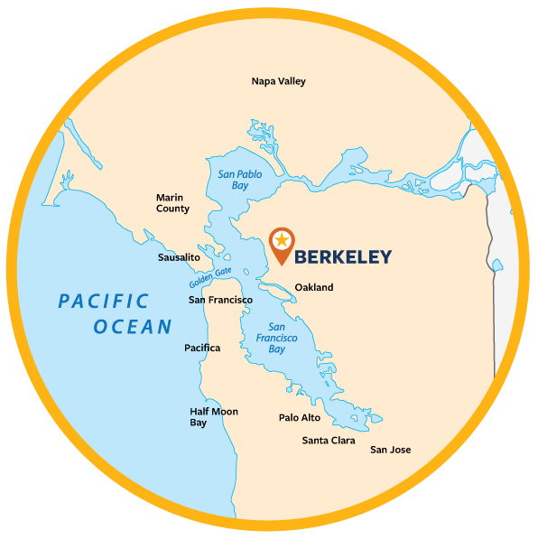
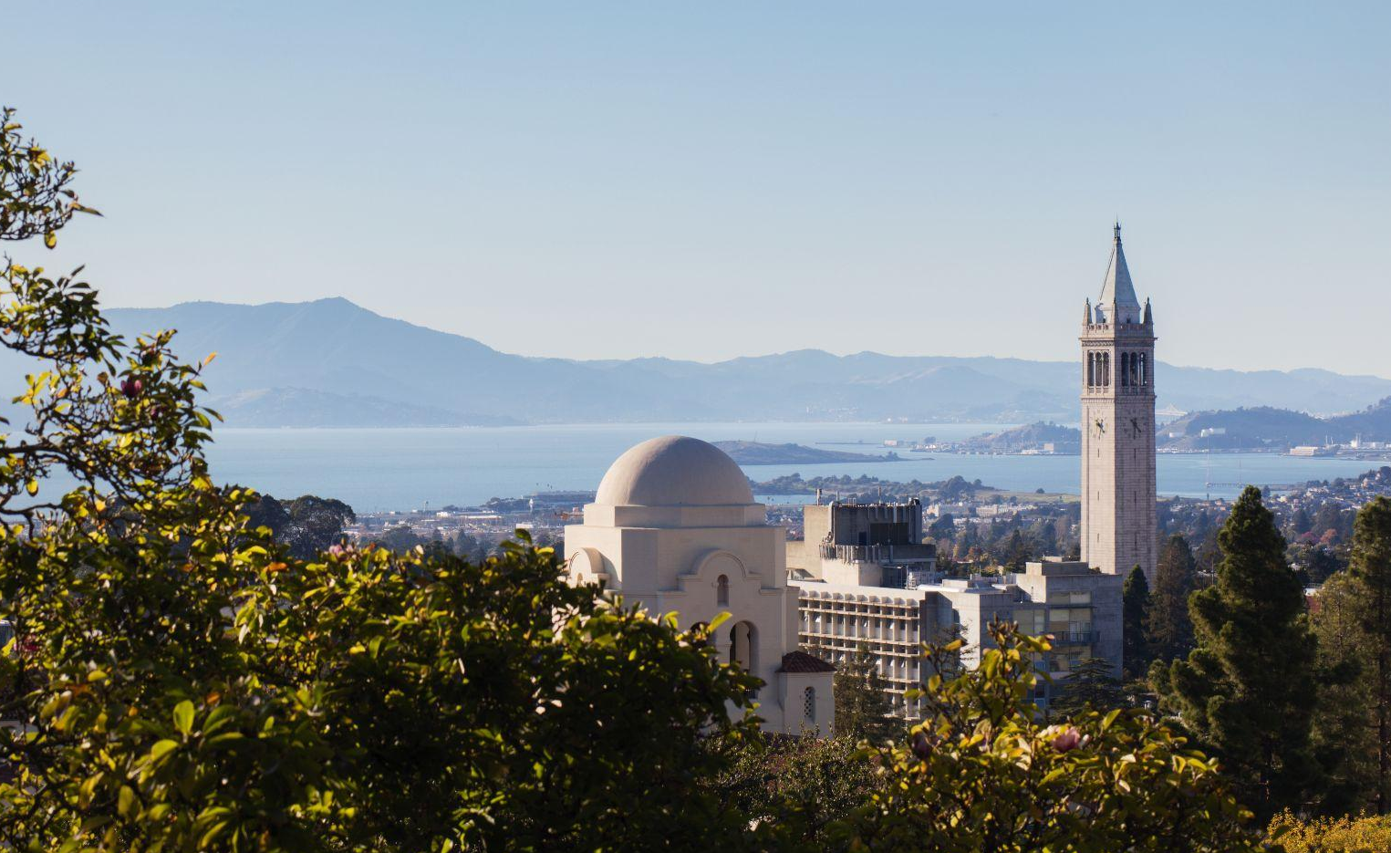
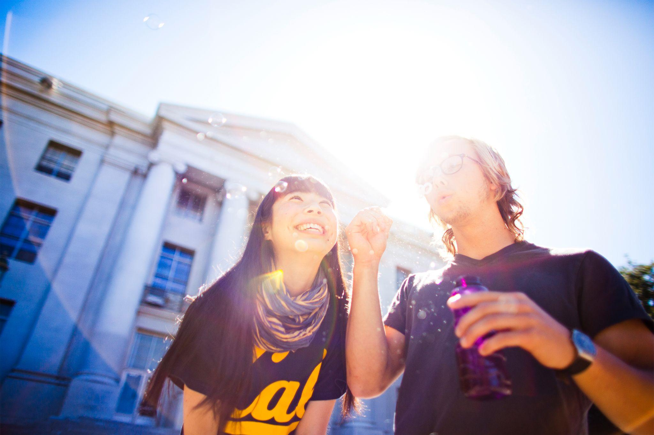
Berkeley CALIFORNIA
Notes:
Berkeley is located in northern California in the San Francisco Bay Area, which is an urban metropolis surrounded by water and nature known for being a global hub of innovation, culture, and recreation.
The Berkeley campus is centrally located in the heart of downtown Berkeley within walking distance of shops, cafes, and restaurants, as well as scenic hiking trails. Our campus features an art museum and cinema, a lush botanical garden, an amphitheater, and numerous academic, cultural, and social events.
Public transportation is accessible throughout the Bay Area, and you can hop on the subway in Berkeley and be in downtown San Francisco in just about 20 minutes. Once there, you can wander through the charming and culturally diverse neighborhoods, attend street fairs and music festivals, and enjoy museums, shopping, restaurants, and nightlife.
Berkeley is also in close proximity to Silicon Valley, the epicenter for advances in technology and product development. As well as countless other popular destinations, including the Yosemite national park, Lake Tahoe, beautiful wine country in Napa Valley and Sonoma, redwood forests, mountains, and beaches. You could even take a short flight to Los Angeles, Las Vegas, or other parts of the United States.
While your main focus as a visiting student will be your studies, we also encourage you to explore your surroundings and take full advantage of your study abroad experience in such an incredible location.

Slide 3
UC BERKELEY
Berkeley fosters innovation, invention, and excellence
Top ranking public research institution
11 Nobel Laureate Faculty currently teaching
Notes:
Let’s watch a short video to familiarize you with our dynamic university: That’s Berkeley Video

Slide 4
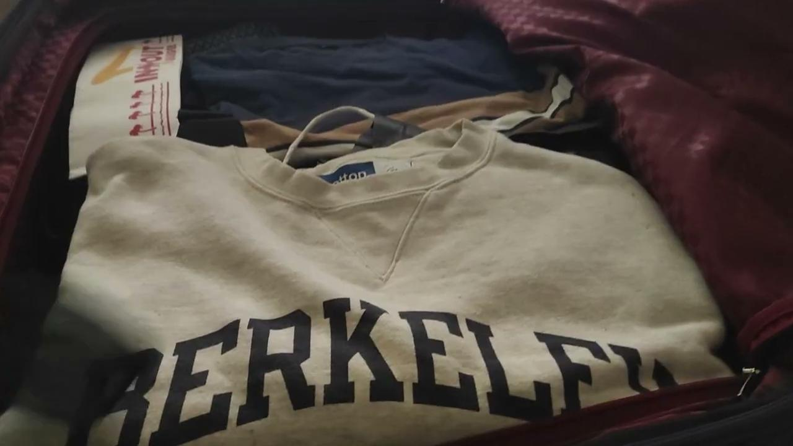
Darren Chan Yu Hao International Visiting Student
Notes:
Let’s watch a video from a visiting summer sessions student, Darren Chan Yu Hao, from Singapore University of Technology and Design, who recorded his time in Berkeley.
Play video 0 - 1:34/1:35 (when first song ends): https://drive.google.com/file/d/1g93Bf7g2ph3ckjXxVW_g2BioYu74gS-3/view?usp=drive_link

Slide 5
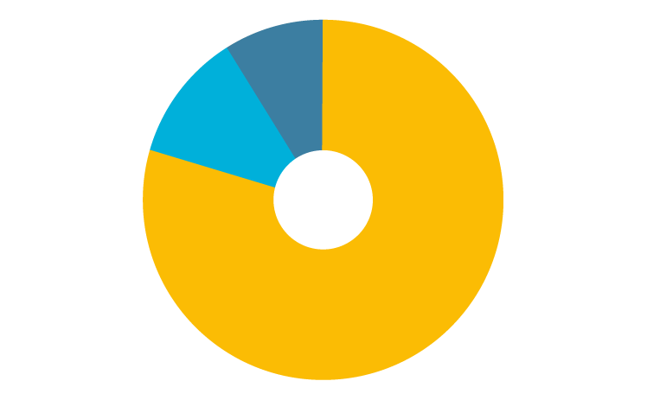
Summer Sessions Students: 2023
11,591
UC Students
2,099 International
Visiting Students
1,237 Domestic
Visiting Students
8%
3,336
Total
Visiting Students
14%
78%
Notes:
Let’s watch a video from a visiting summer sessions student, Darren Chan Yu Hao, from Singapore University of Technology and Design, who recorded his time in Berkeley.
Play video 0 - 1:34/1:35 (when first song ends): https://drive.google.com/file/d/1g93Bf7g2ph3ckjXxVW_g2BioYu74gS-3/view?usp=drive_link

Slide 6
The Value of UC Berkeley Summer Sessions
Accessibility Open to all!
Affordability No out-of-state fees!
Quality Education World-renowned research institution.
Diversity Meet and study alongside Berkeley students and visiting students from around the world!
Experience Berkeley as a Berkeley student & earn an official UC Berkeley transcript

Slide 7
Student Testimonials
SOFIE BUKOVSKA
International Visiting Student
Notes:
Let’s hear from Sofie, an international visiting student from the Czech Republic who attended Summer Sessions and enjoyed her experience so much that she extended her time at Berkeley through the fall and spring semesters by joining another visiting student program.
Video: https://www.youtube.com/watch?v=XxKFxMjHv6Y

Slide 8
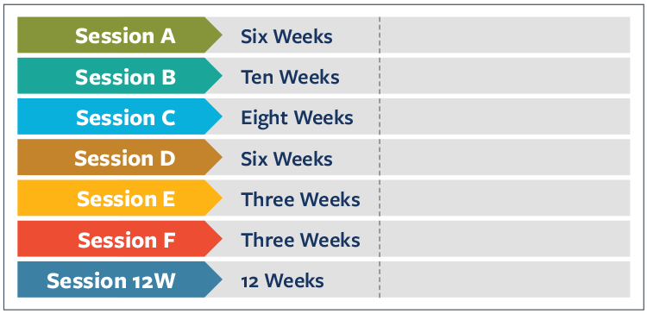
Summer Sessions Calendar
Choose from 3, 6, 8, 10, or 12-week sessions
May 20 – June 28
June 3 – August 9
June 17 – August 9
July 1 – August 9
July 22 – August 9
July 1 - July 19
May 20 - August 9

Slide 9
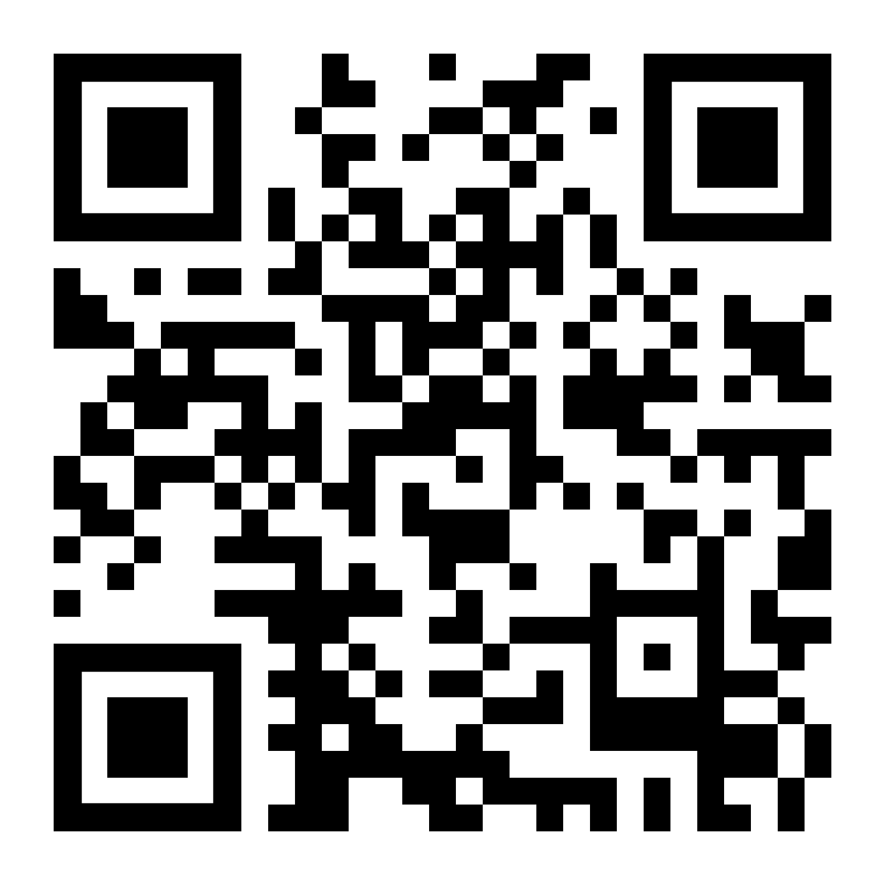
Summer Courses
600+ courses in over 80 disciplines
In person & Online
Regular credits at accelerated pace
Primarily undergraduate level
Prerequisites may apply
Certificate Programs
Berkeley Academic Guide: classes.berkeley.edu

Slide 10
ACADEMIC CULTURE
Faculty office
hours
Continuous assessment
Engaged learning & participation

Slide 11
Student Life & Campus Culture
Principles of Community
Equity, Diversity, and Inclusion
Student community-building & campus events
Campus Safety Services

Slide 12
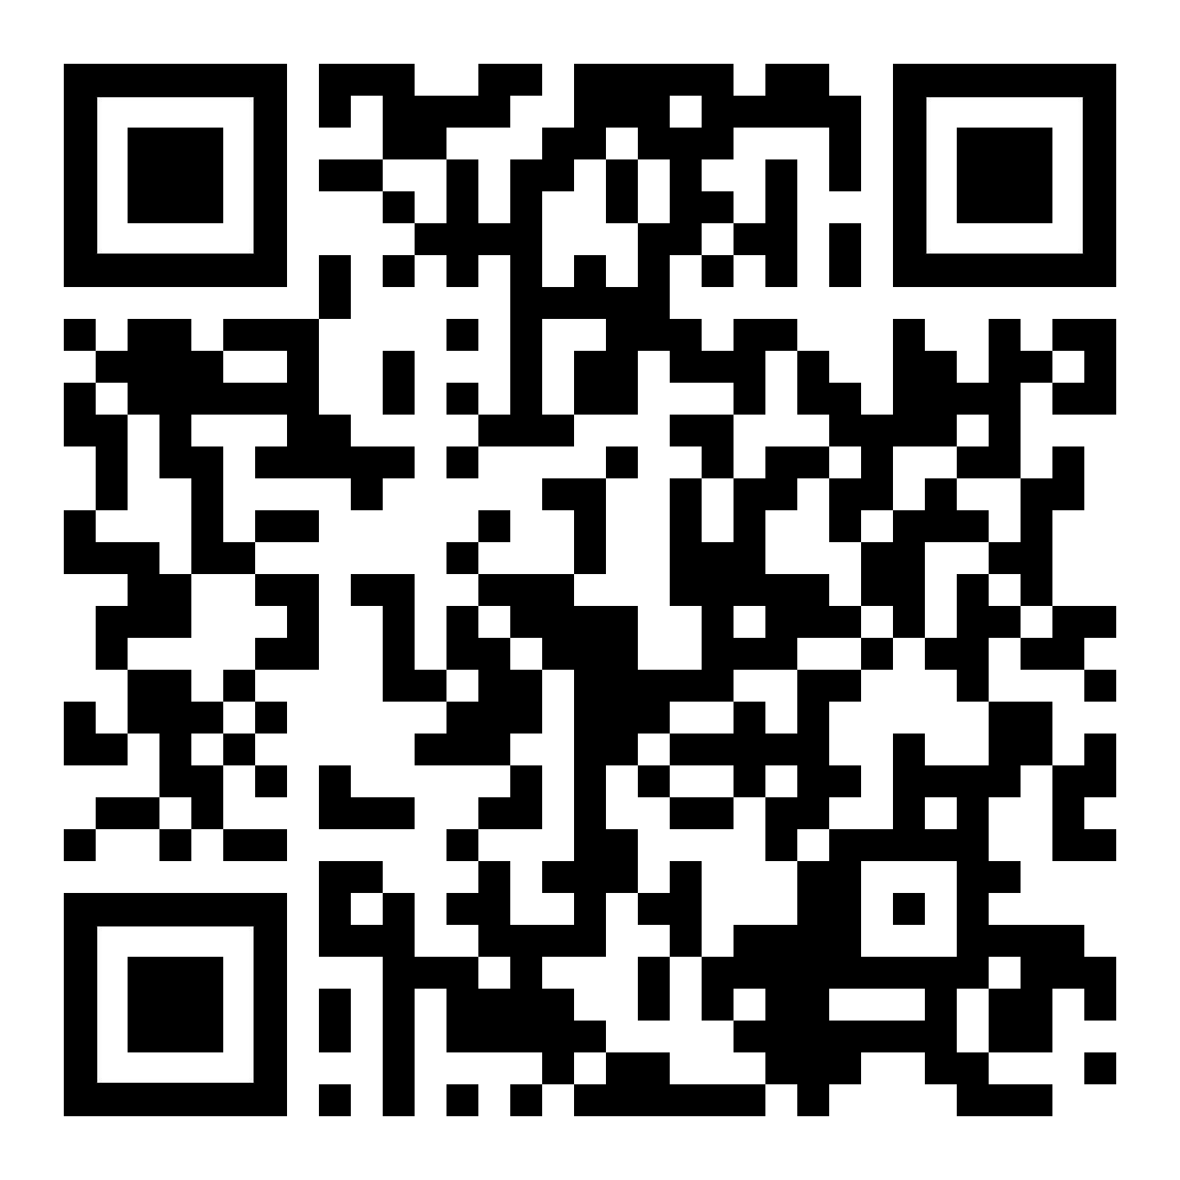
Summer Housing
Students are responsible for arranging their housing
Residence Halls
Includes meal plan for the dining halls, campus restaurants and cafes
Also includes study areas and community-building events
Other housing options
International House
Co-operative Housing
Private dormitories and apartments
Sublets
Homestays
To view a list of housing options both on and off-campus please visit: summer.berkeley.edu/
student-services/student-housing

Slide 13
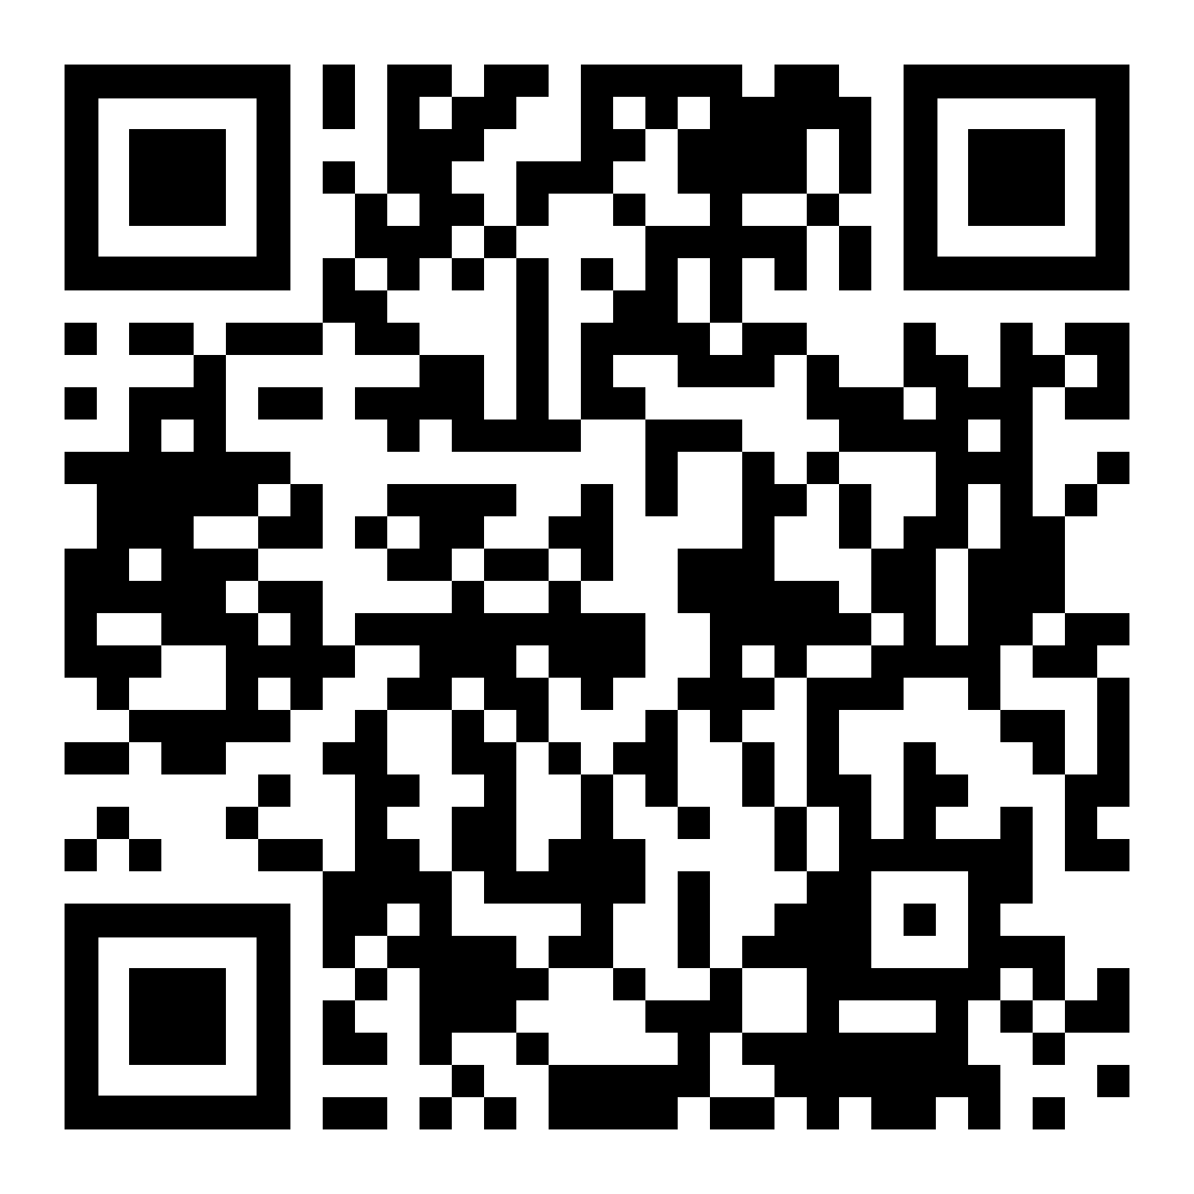
Summer Sessions 2024 Fees: International Visitors
Application Fee: $25
Tuition: $595 per unit charge
Registration Fee: $550
Document Management Fee: $68
International Service Fee: $500 Waived for HKBU Students!
How to calculate tuition:
Multiply the “per unit” fee by the amount of units you plan to enroll in
Notes:
Full-Time Unit Requirements: https://summer.berkeley.edu/visa/summerreq

Slide 14
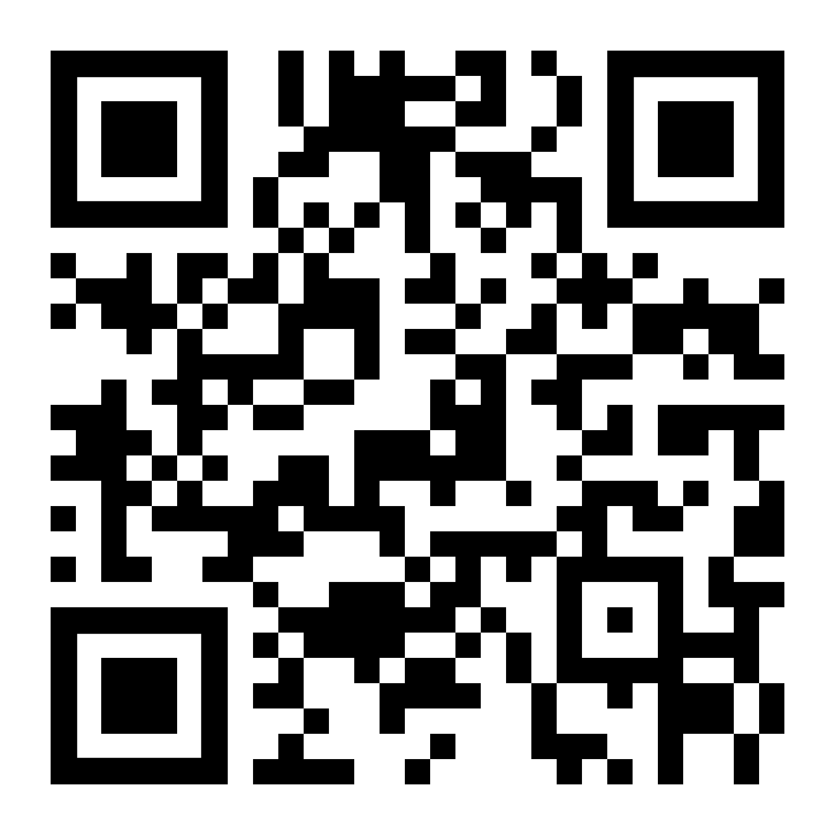
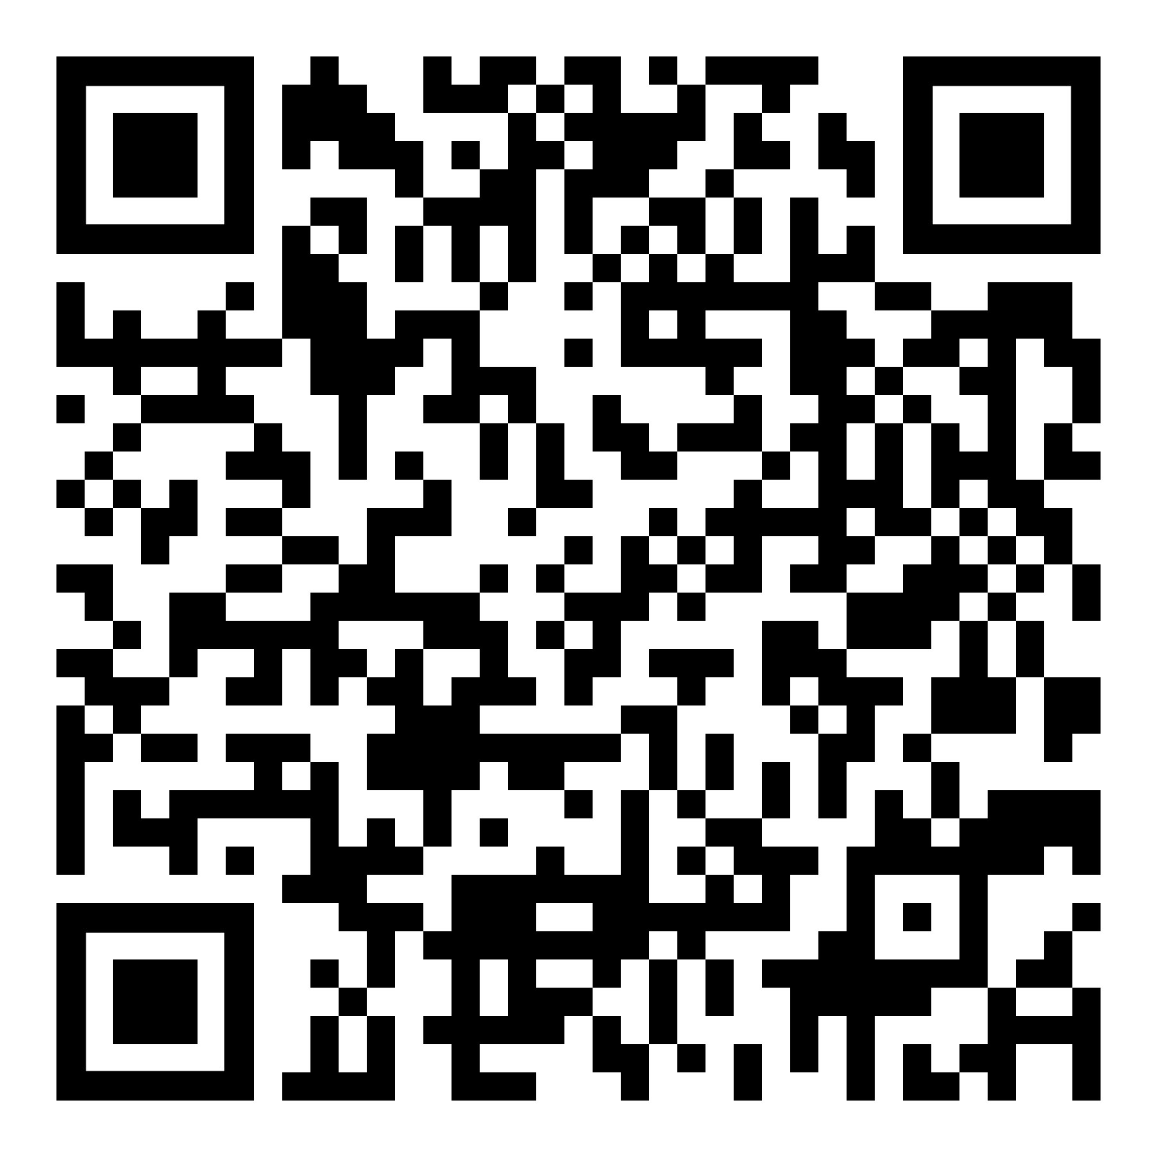
Summer Sessions Enrollment
APPLICATION OPENS FEBRUARY 1, 2024
Review Summer Sessions policies, fees, and deadlines on the website at summer.berkeley.edu.
Submit an online application, enroll in courses, and pay fees!
Step-by-step instructions available on our website.
International Visiting Student Checklist: summer.berkeley.edu/international/international-checklist

Slide 15
WHY BERKELEY?
Challenge Yourself
Be Social
Explore

Slide 16
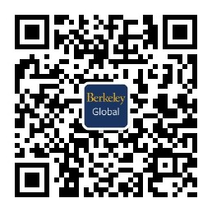
More Information
summer.berkeley.edu
summer@berkeley.edu
@berkeleysummer
@berkeleysummer
@UCBerkeleysummer
Berkeley Global on WeChat

